Slide 1



Phase-I Trigger Readout Electronics Upgrade for the ATLAS Liquid-Argon Calorimeters
TIPP17 – ? MAY 2017
Alessandra Camplani – Universita’ degli studi and INFN Milano
On behalf of the ATLAS Liquid Argon Calorimeter group

Slide 2
Outline
Introduction
LHC, ATLAS, LAr
Phase I Upgrade
LAr Front End Electronics
LAr Back End Electronics
Demonstrator
Summary

Slide 3
Introduction

Slide 4
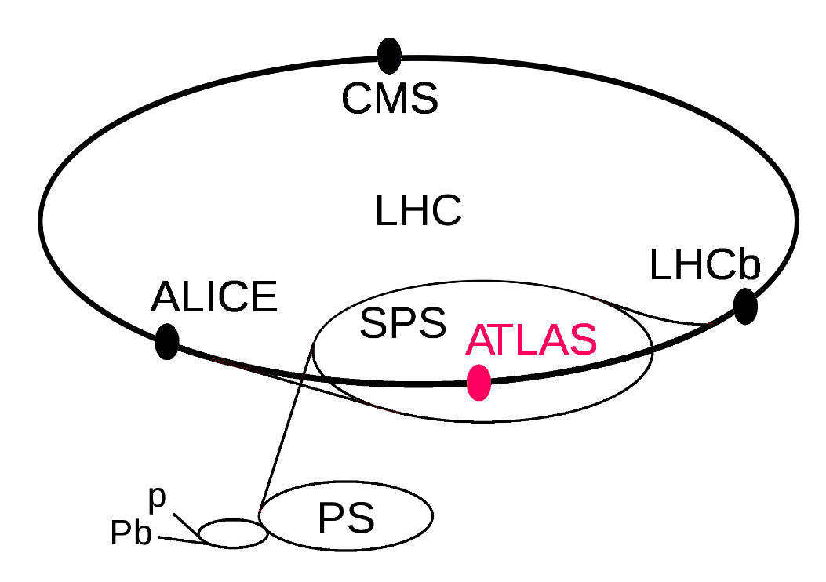
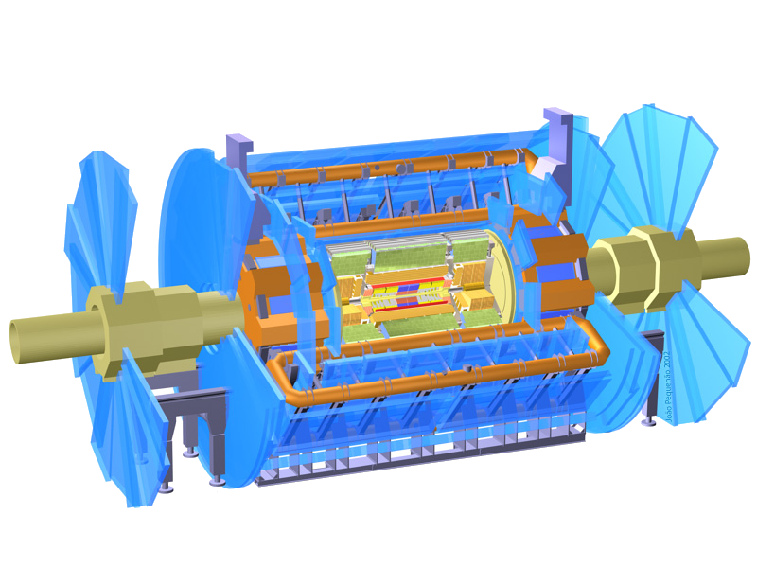
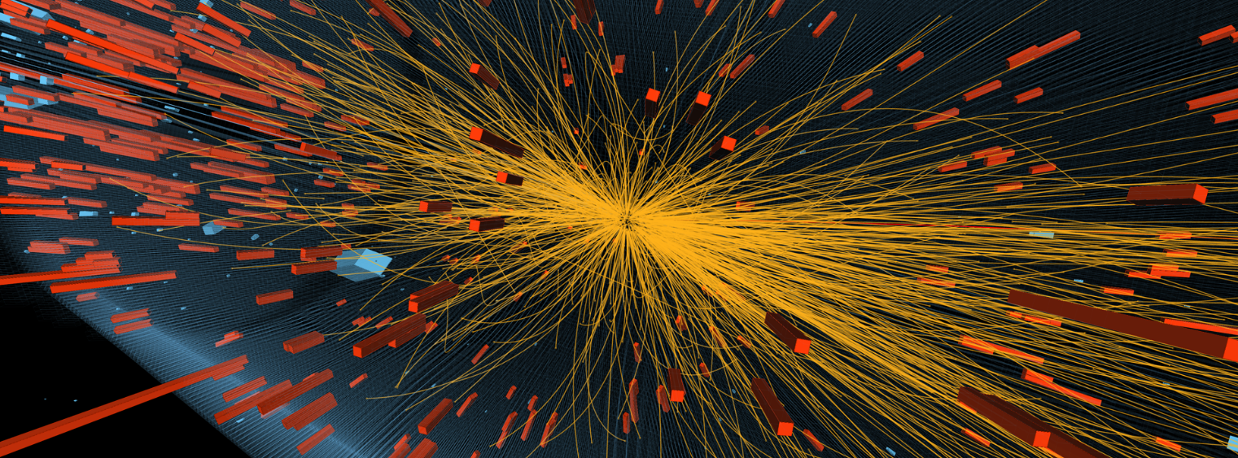
Context – LHC and ATLAS
Large Hadron Collider (LHC) at CERN, Geneva, Switzerland
27km circumference
depth between 50 to 175m
four collision points
ATLAS: A Toroidal LHC ApparatuS
46m long, 25m diameter and 7000 tons
Purpose:
Answer fundamental physics questions
Standard model

Slide 5
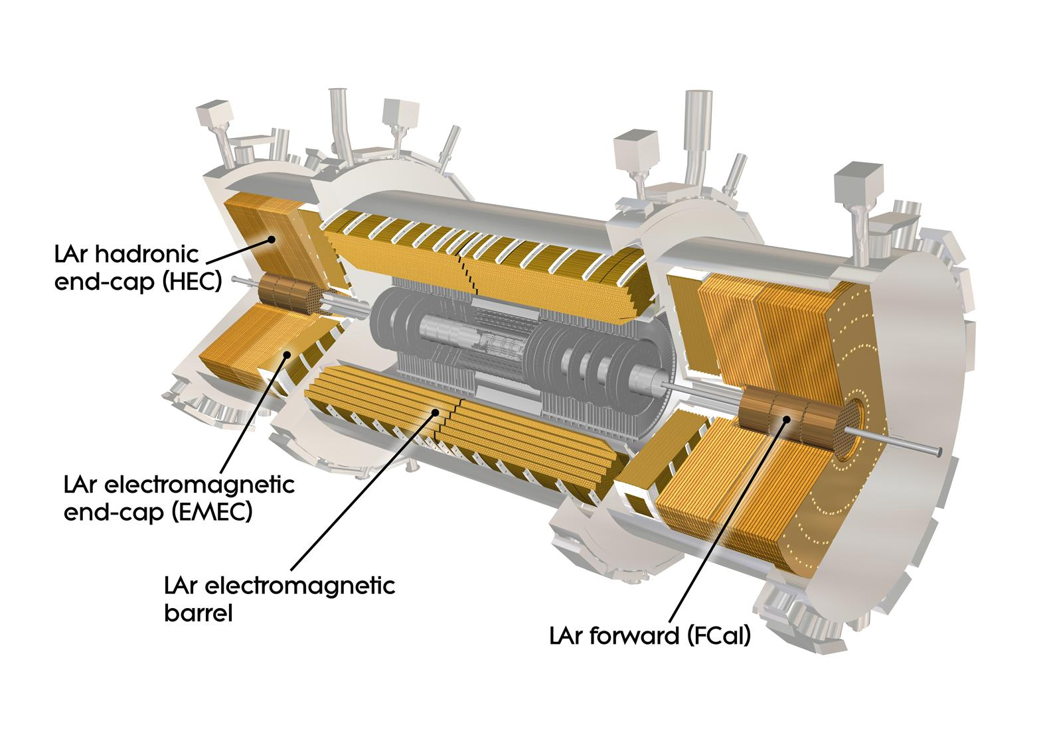
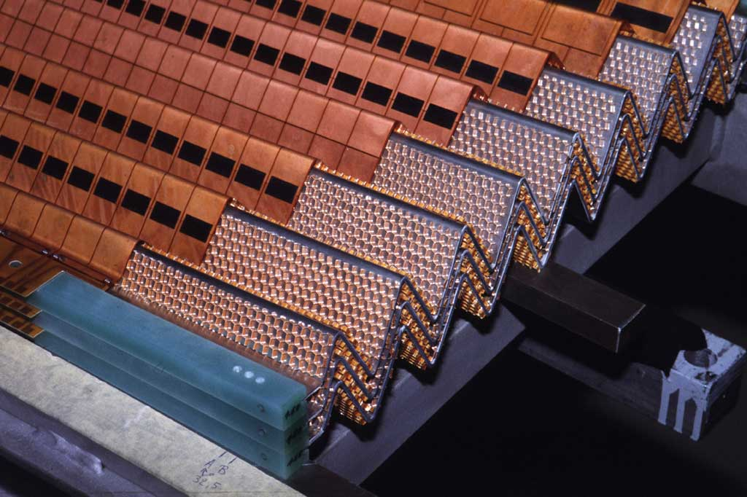
The Liquid Argon (LAr) Calorimeter
The LAr calorimeter is a sampling calorimeter with accordion-shaped lead absorbers and copper-kapton electrodes.
180K channels for the full readout of the electromagnetic (EMB+EMEC), hadronic (HEC) and Forward (Fcal) calorimeters
3K channels for analog Trigger readout
Front End crates: ≈ 1600 Front End Boards (FEB)
Back End crates: 200 Readout Out Driver boards (ROD)

Slide 6
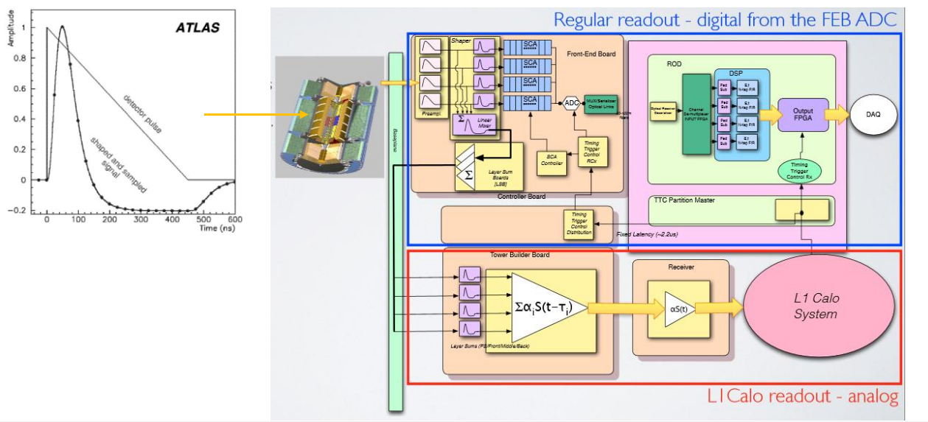
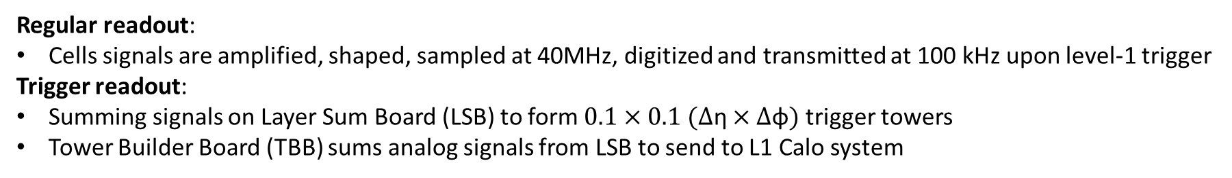
The current electronics
Regular readout:
Cells signals are amplified, shaped, sampled at 40MHz, digitized and transmitted at 100 kHz upon level-1 trigger
Trigger readout:
Summing signals on Layer Sum Board (LSB) to form $0.1×0.1 (∆\text{η}×∆\text{φ})$ trigger towers
Tower Builder Board (TBB) sums analog signals from LSB to send to L1 Calo system

Slide 7
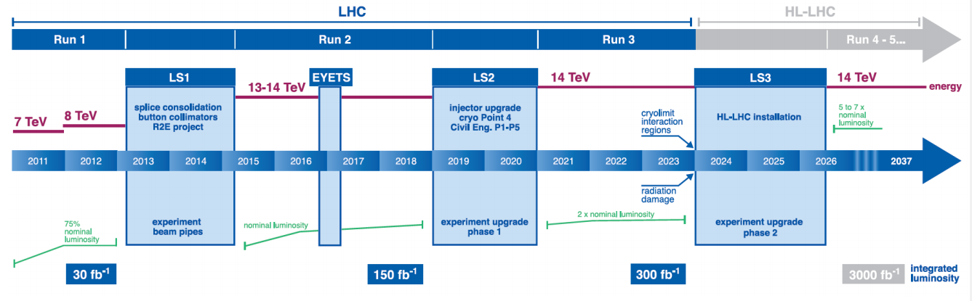
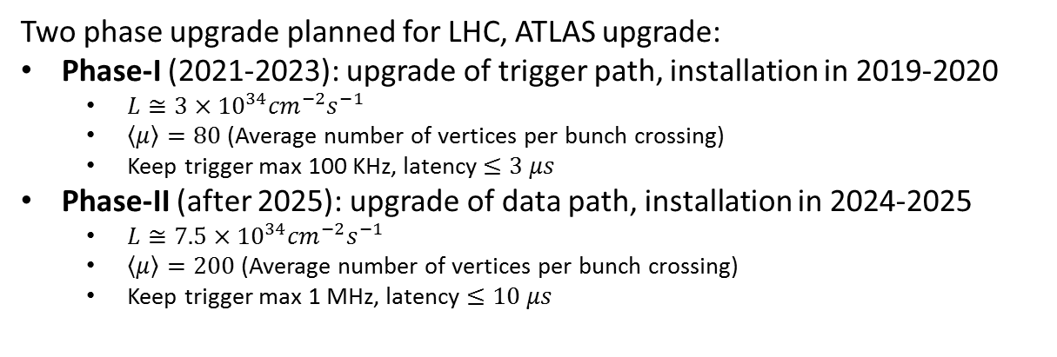
LHC Schedule
Two phase upgrade planned for LHC, ATLAS upgrade:
Phase-I (2021-2023): upgrade of trigger path, installation in 2019-2020
$L≅3×{10}^{34}{cm}^{−2}s^{−1}$
$\left\langle \left.μ\right\rangle \right.=80$ (Average number of vertices per bunch crossing)
Keep trigger max 100 KHz, latency $≤3 μs$
Phase-II (after 2025): upgrade of data path, installation in 2024-2025
$L≅7.5×{10}^{34}{cm}^{−2}s^{−1}$
$\left\langle \left.μ\right\rangle \right.=200$ (Average number of vertices per bunch crossing)
Keep trigger max 1 MHz, latency $≤10 μs$
Upgrade of LAr trigger readout
Upgrade of LAr main readout

Slide 8
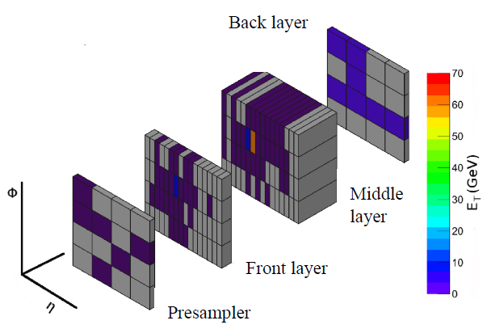
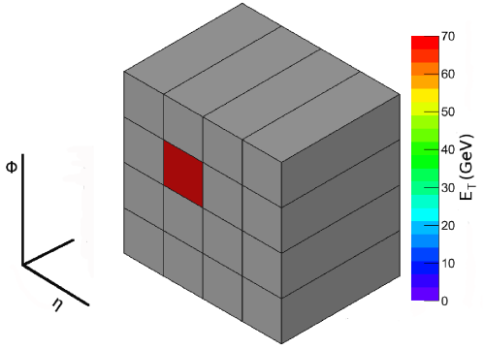
Calorimeter Upgrade
LAr Phase-I upgrade: new calorimeter trigger electronics with increased granularity and functionality for LAr calorimeter level 1 trigger
Trigger Tower
Super Cells
LAr Phase 1
Upgrade
Trigger Tower to Super Cells:
Granularity increased 10 times per each trigger tower
Provided information for each calorimeter layer for the full η range
Finer segmentation in the front and middle layers of the EM barrel and endcap
Higher resolution and shower information
Deal with the luminosity increase, maintaining a low-pT lepton threshold and keeping the same trigger bandwidth

Slide 9
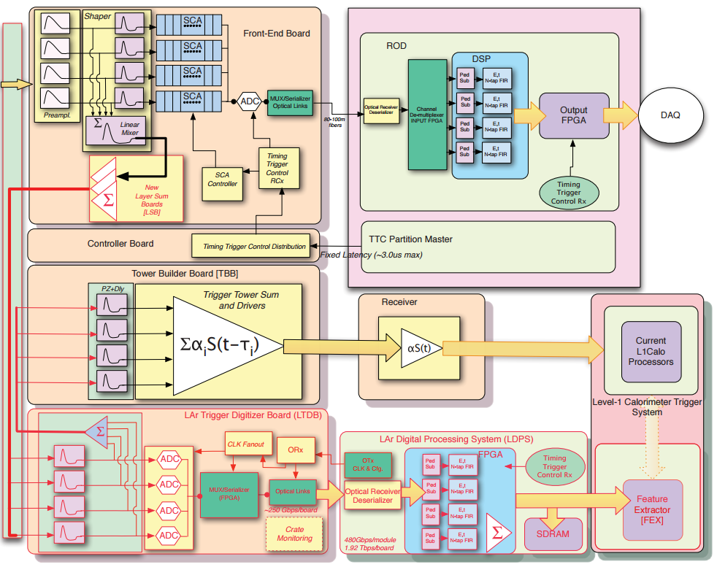
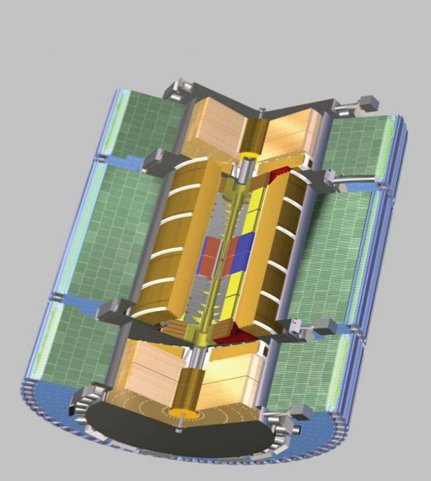
LAr Phase-I Project
Layer Sum Board
(LSB)
Baseplane
LAr Trigger Digitizer
Board (LTDB)
LAr Digital Processing System (LDPS)
New elements are highlighted in RED

Slide 10
Front-End (FE) Upgrade

Slide 11
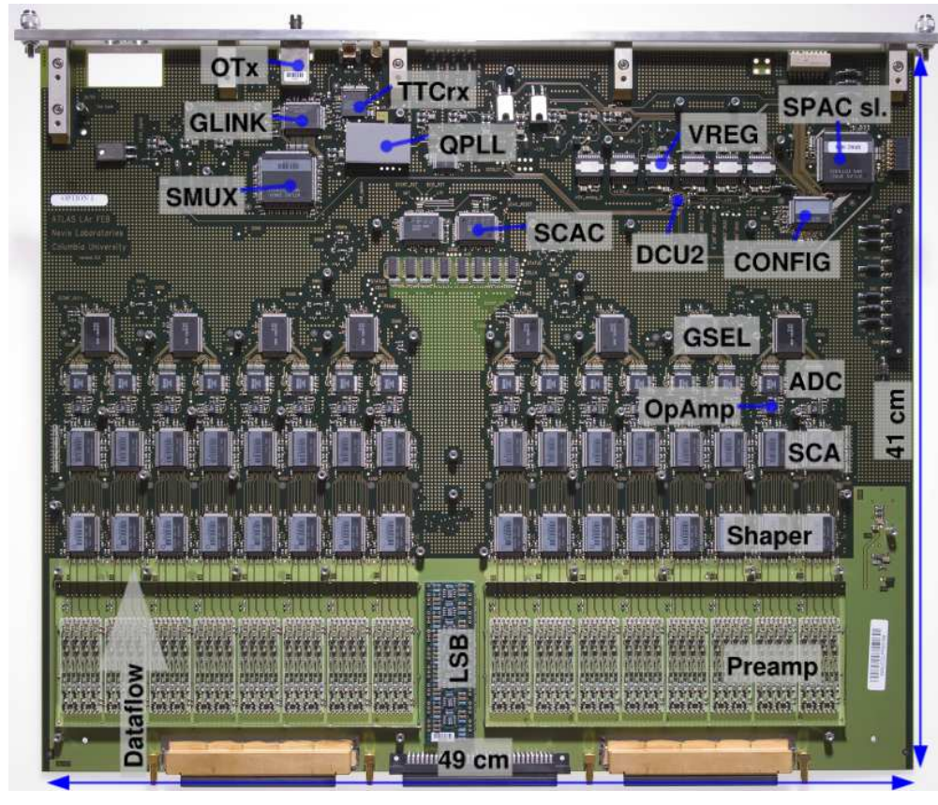
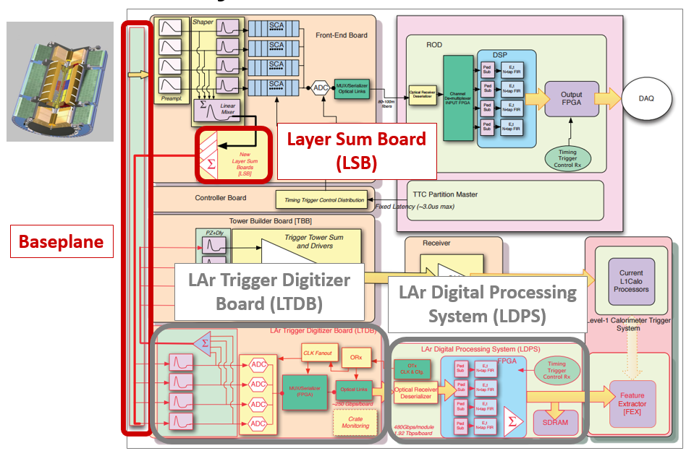
FE electronics components
FEB currently installed in USA15
New Layer Sum Boards (LSB) to perform analog sums for super cells
New Baseplane to keep compatibility with existing setup
LAr Trigger Digitizer Boards (LTDB) with radiation-tolerant custom ASICs
Nevis ADC
LOCx2
LOCld
Baseplane

Slide 12
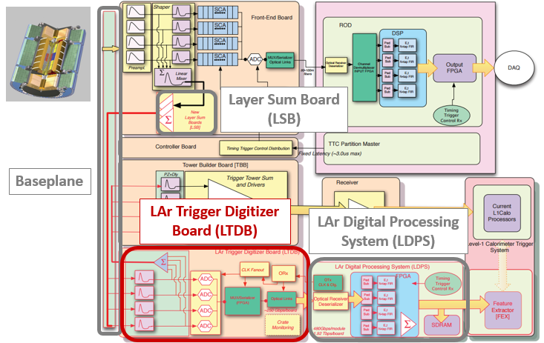
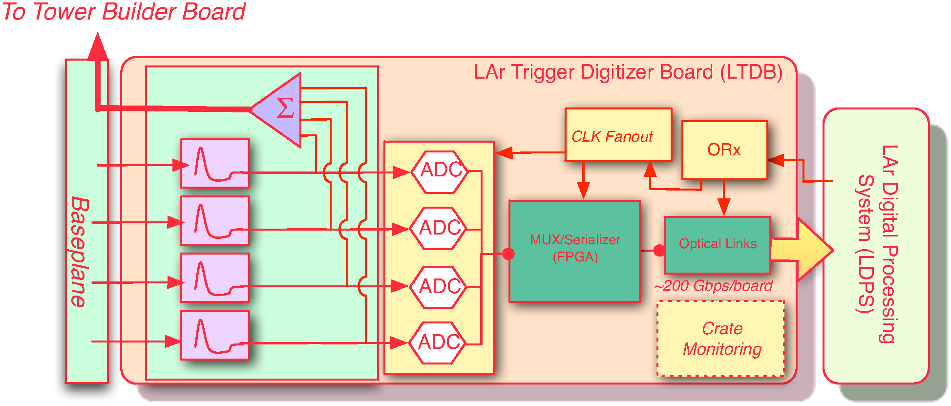
LAr Trigger Digitizer Board (LTDB)
124 LTDBs to readout the 34K Super Cells of the LAr calorimeter
1 LTDB handles analog input from 320 Super Cells
Digitizes all analog signals at 12 bits @ 40MHz using 80 custom ADC
Generate analog sums to keep compatibility with old system
Transmits digital signals using 40 optical links @ 5.12Gbps on custom ASIC
Receives TTC clock and data through 5 GBTx links
Design is made in collaboration between several groups
Phase-II compatible

Slide 13
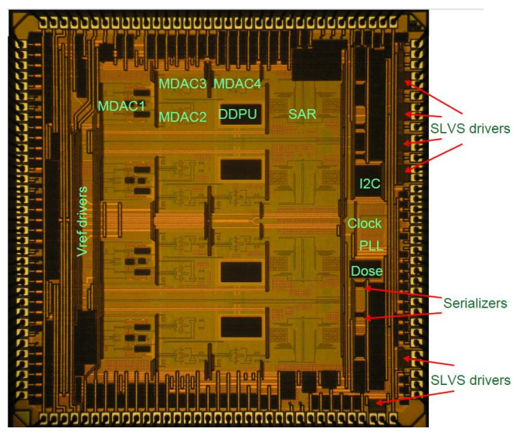
LTDB: NEVIS ADC
Quad 12 bits hybrid pipeline SAR ADC (IBM8RF 130nm CMOS)
40 MSPS
ENOB 11 bits
Dinamic range
Typically 11.8 bits
Power dissipation < 50 mW/channel
112.5 ns latency
Radiation tolerant
Die:
3.6 x 3.6 mm
72 pins QFN

Slide 14
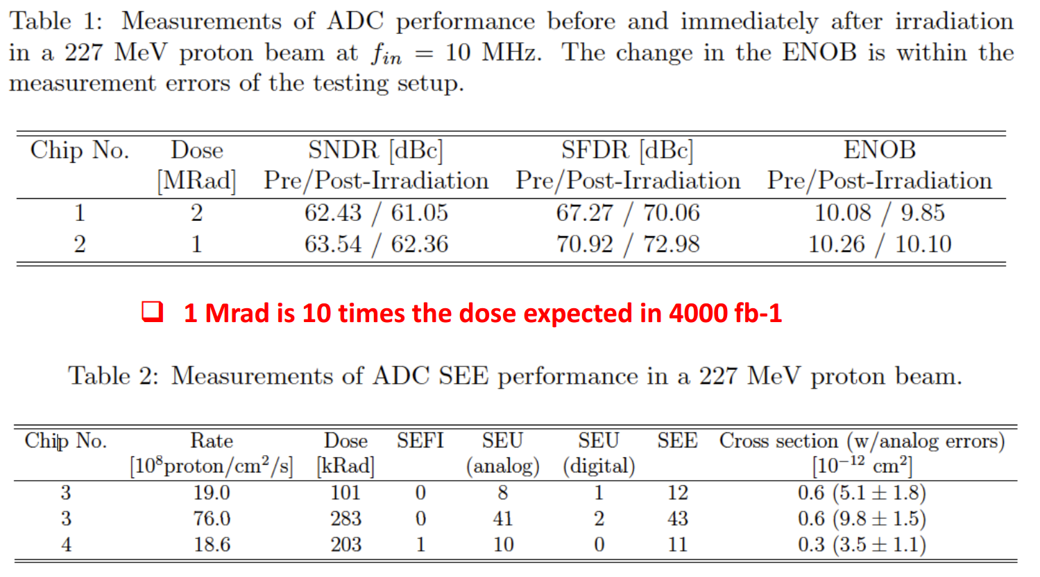
NEVIS ADC: radiation tolerance
Total Dose
Single Event Effect

Slide 15
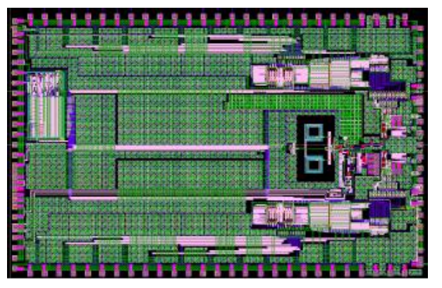
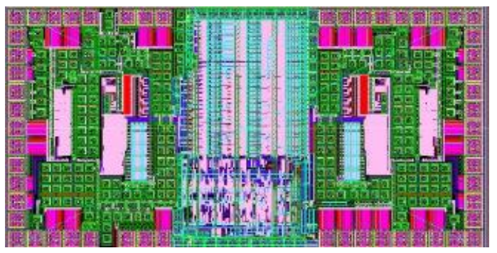
LTDB: LOCx2 & LOCld
Layout of the LOCx2 ASIC
LOCx2:
Silana Foundry 250 nm, Silicon-on-Sapphire
DUAL 8 x 14 bits serializer
5.12 Gbps outputs
Nevis ADC compatible
Radiation tolerant
LOCld:
Dual channel VCSEL driver
Radiation tolerant
Die:
2.114x1.090mm
40 pins QFN
Power consumption 1 W
Fixed Latency < 75 ns
Die:
6.036 x 3.68 mm
100 pins QFN
Layout of the LOCld

Slide 16
LOCx2 & LOCld: radiation tolerance
LOCx2
Eye Diagram 5.12 Gbps
2 Channels chip soldered on PCB
Total jitter ~ 50 ps (loop filter = 800 kHz)
Eye Diagram after 182 krad TID
Low or high dose rate (3krad/hr or 30 krad/h)
LOCld
No eye diagram change after 200 krad
2 channels shifted for display clarity
Current change after irradiation < 10%

Slide 17
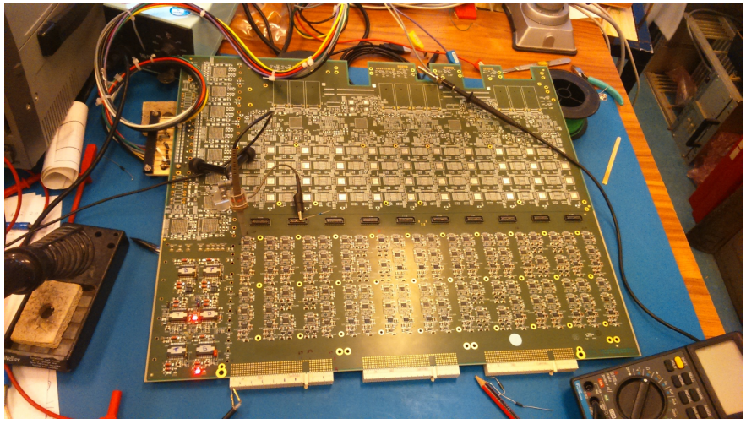
LTDB Development
LTDB pre-prototype 320ch
Pre-prototype PCB
FPGA used to replace LOCx2
LTDB prototype
Analog section and digital section are designed by different institutes, and Gerber merged for fabrication
Power section is realized on a mezzanine
2 LTDB prototypes could be used to replace LTDB demonstrators in January 2018

Slide 18
Back-End (BE) Upgrade

Slide 19
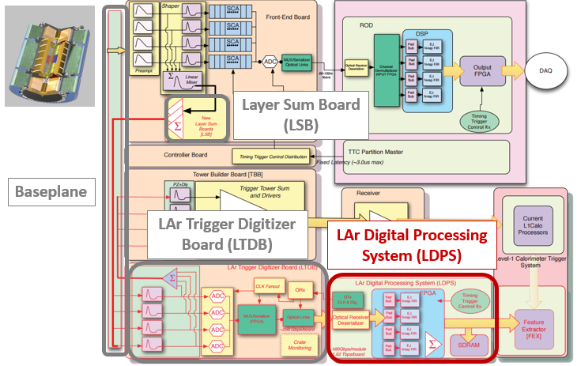
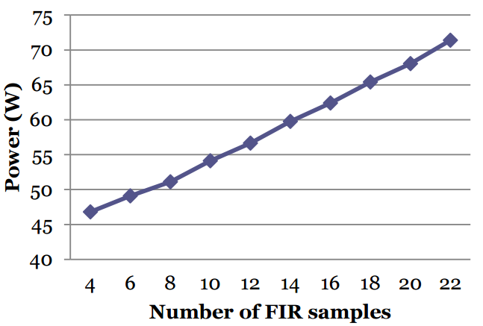

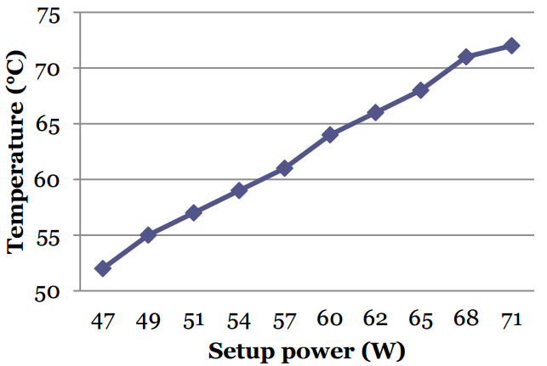

LDPS Development
LATOME V2
LATOME
Based on Altera Arria10 FPGA
LATOME V1 is working, but with some power issues
Design has been updated
LATOME V2 ready at the end of 2016: is working fine and power issue seem fixed
FPGA core current decreased
Setup power decreased -> More firmware for the same power
Fibers: work in progress for pre-series
Setup power / Nb of FIR samples
LATOME V2
Carrier board V1 2015, FDR passed with AMC
V2 available since Spring 2016
On board Ethernet HW chip
V3 already assembled
Test ongoing
To be used in further integration
FPGA temperature / Setup power
LATOME V2

Slide 20
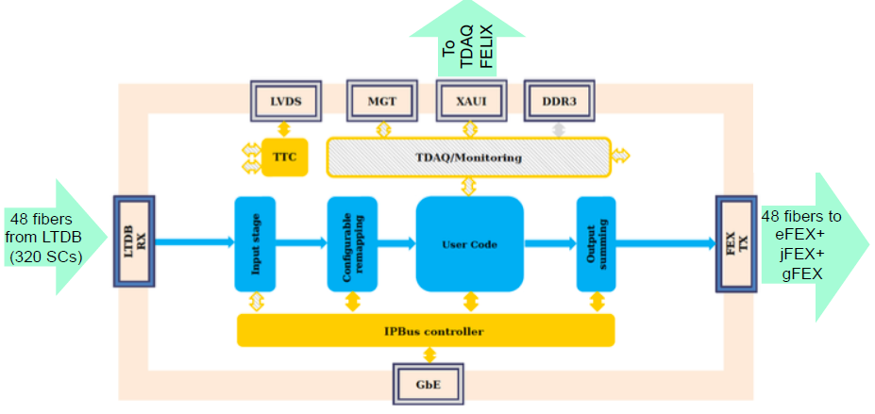
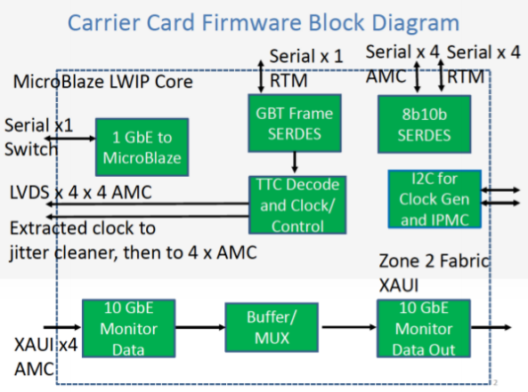
LDPS Firmware
LATOME firmware development ongoing
Block deliverables:
Seven groups contributing
Emphasis on simulation and integration
Latency and resources verified at each major step
Adapt to System Test milestones : implement on HW
Carrier firmware development ongoing
Development of Carrier firmware continues with emphasis on completing a baseline project
Testing of Carrier hardware and firmware at EMF will be ongoing (TTC, 1GbE, 10GbE etc.)
Stability issue of uBlaze project to be addressed

Slide 21
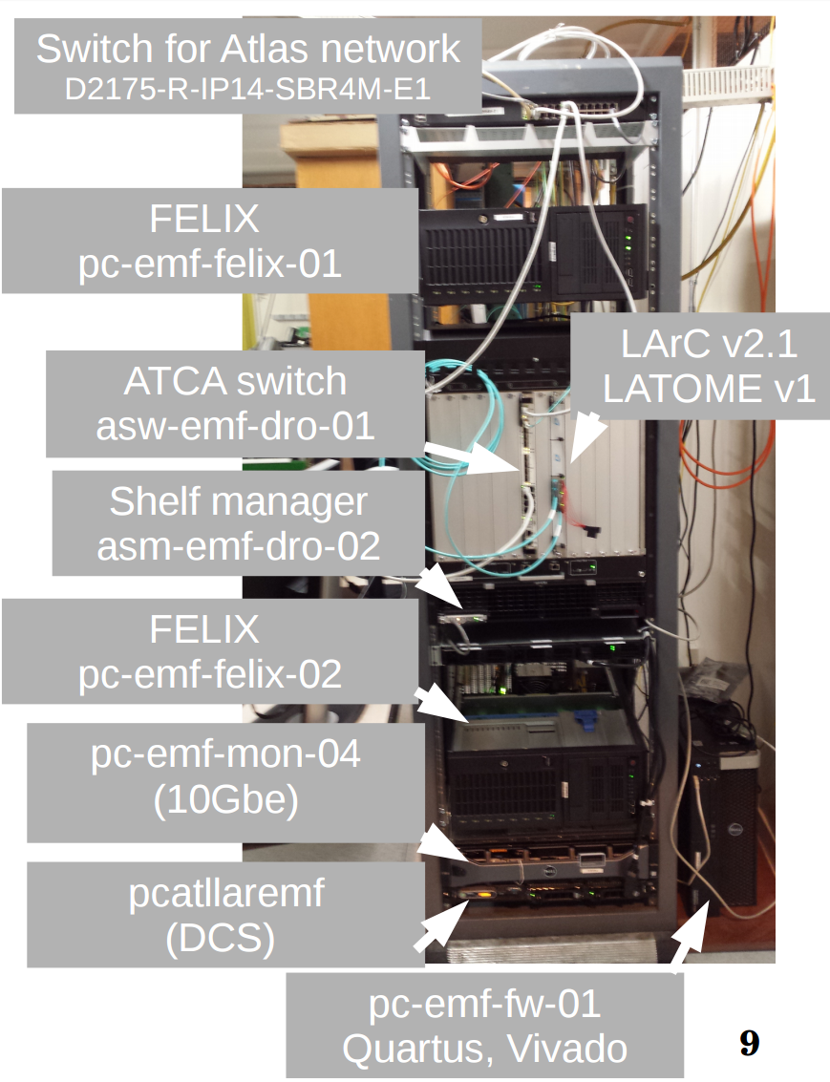
Back End System Test
Demonstrate feasibility of BE system
Pass PRR for releasing series board production
Show operation of all parts of system
Verify operation of FPGAs
Test Power-Cooling in ~final conditions
Boost coding, testing and debugging of FW
Boost coding, testing and debugging of Online SW (incl. TDAQ)
Eventually connect to LTDB
Full system test
Several milestones have been reached: moving forward for the next steps
PRR expected in late spring

Slide 22
Demonstrator

Slide 23
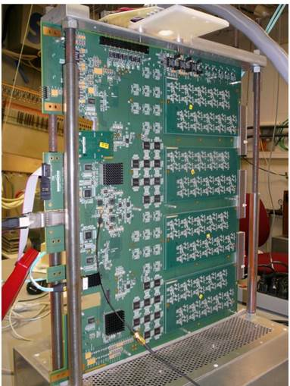
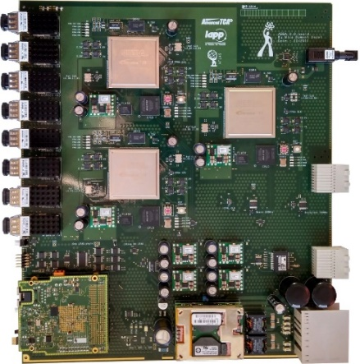
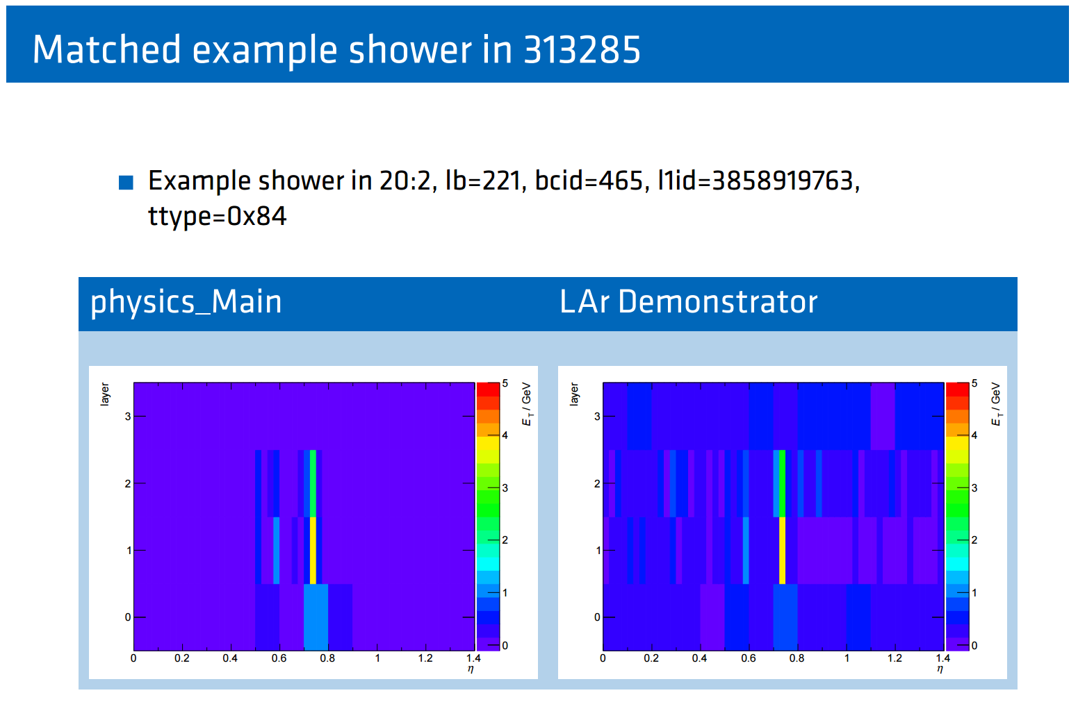
Demonstrator
Demonstrator installed in summer 2014
2 LTDBs readout via ABBA boards
Successful 2016 ATLAS pp data taking
No L1Topo during HI period
LArABBA partition active for some runs, triggering on Physics + Calo
Development and analysis works are making progress
Continuous development on firmware and software
Corrected latency shift happening during long runs
Introduce ID for tracing packets between FPGAs
Integration of ABBA as a new segment of ATLAS

Slide 24
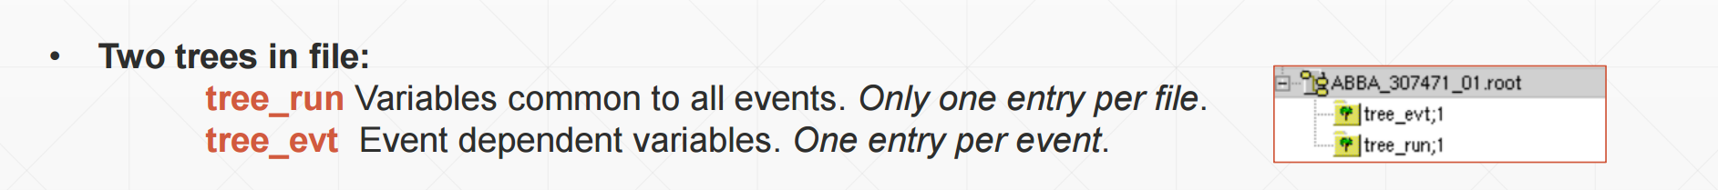
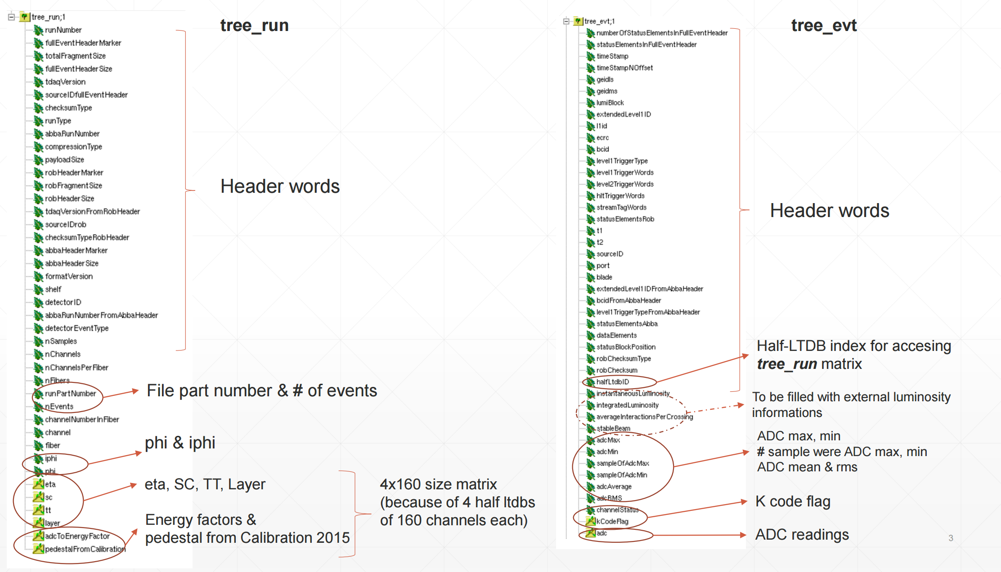
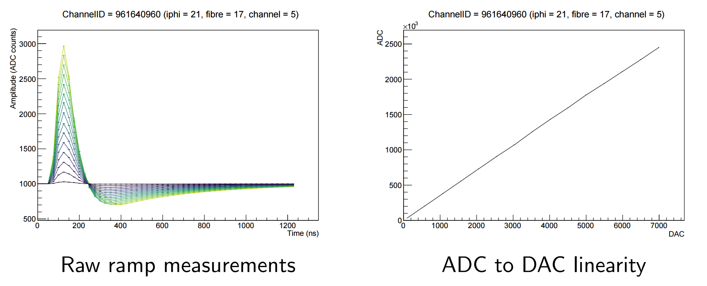
LAr Demonstrator
Development and analysis works are making progress
Continuous development on firmware and software
Corrected latency shift happening during long runs
Introduce ID for tracing packets between FPGAs
Integration of ABBA as a new segment of ATLAS
Calibration data taking has been carried out
New Ntuples format for demonstrator data

Slide 25
Summary

Slide 26
Summary
LAr Demonstrator has successful 2016 ATLAS pp data taking
Preparation for 2017 run has started
Baseplane is making progress
Manufacturer identified for RF springs, trying to pass full PO from CERN
LSBs production ongoing
Passed PRR in October successfully
Front end LTDB
Nevis15 ADC tested on 64 channels board and OK, plan to address it by QA
LOCx2 16/20 wafer are ok, proof of functioning at the end of February
LTDB board development is progressing well with baseline design: FDR by spring 2017
Back end LDPS
LATOME V2 much improved in terms of power, temperature and voltage drop vs V1
cabling of 13 boards in process and fibers being ordered
12 LATOME V2 boards should be available for the system test by end of March
Carrier V3 assembled and test ongoing
Firmware development is making good progress and BE system integration is marching to the next major milestone

Slide 27
Backup slides

Slide 28
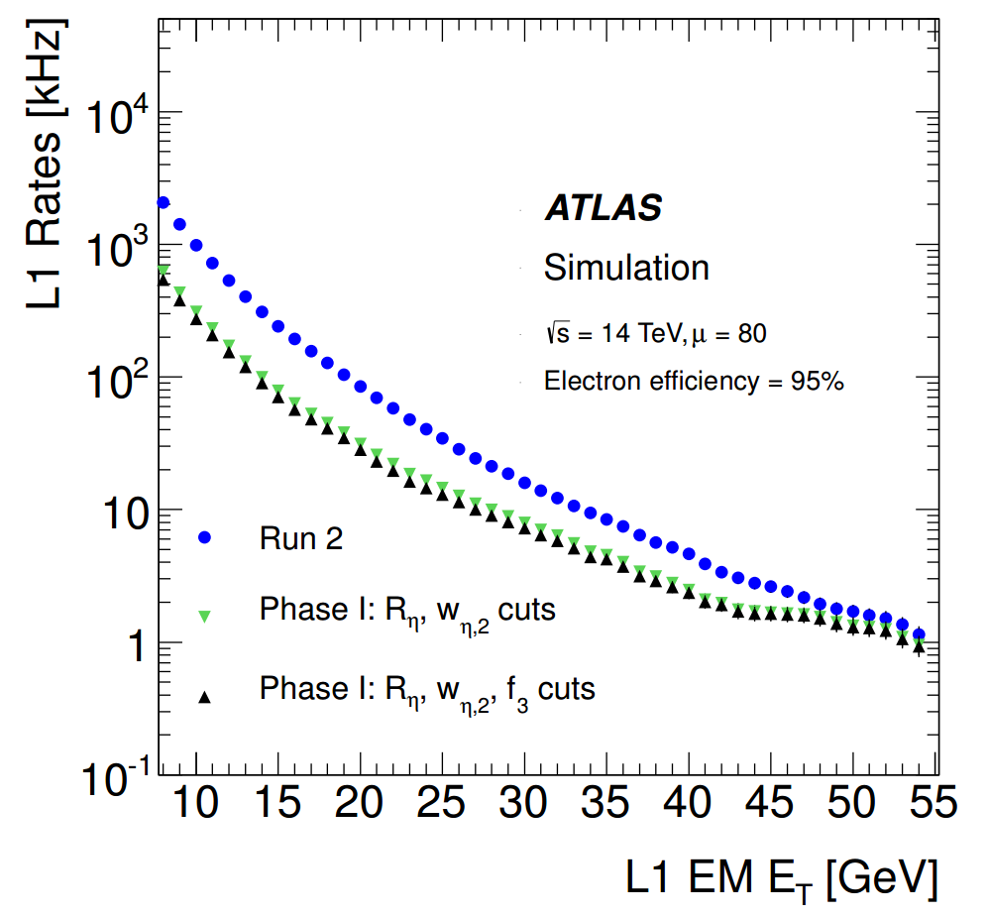

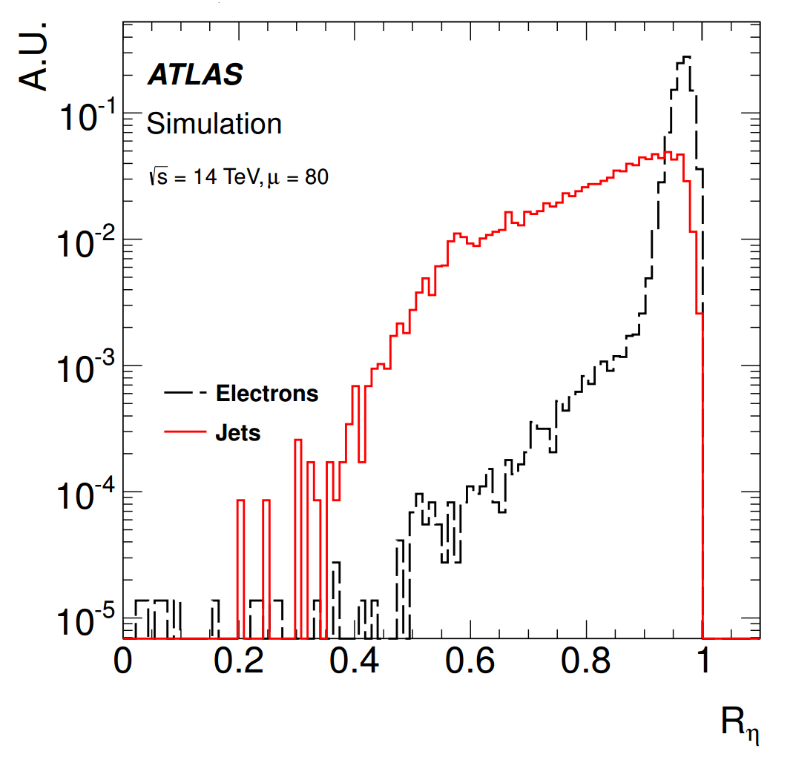
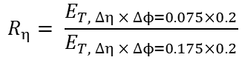
Motivation and strategy
Main goals: deal with the luminosity increase, maintaining a low-pT lepton threshold and keeping the same trigger bandwidth
With the new Phase-I electronics:
Make use of shower shape variables: a more sophisticated rejection of jet backgrounds
Level-1 threshold for a given bandwidth of e.g. 20 kHz (28.5 GeV assuming Run 2 conditions) could be lowered by 7 GeV
$$R_{η}= \frac{E_{T, ∆η × ∆ϕ=0.075×0.2}}{E_{T, ∆η × ∆ϕ=0.175×0.2}}$$
Ratio between the transverse energy of a Super Cells group of dimension 3x2 and the transverse energy of a group 7x2.
Ratio
2.5
~
ΔET
~
7 GeV

Slide 29
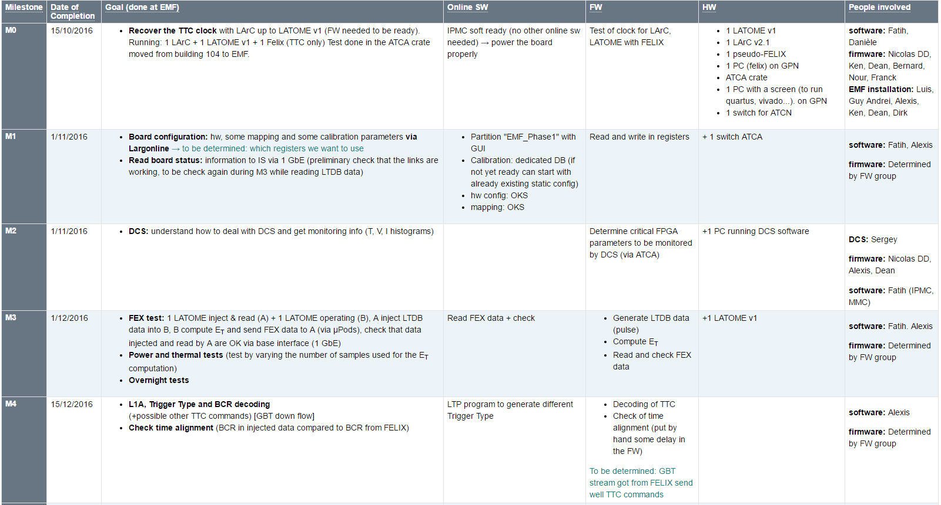
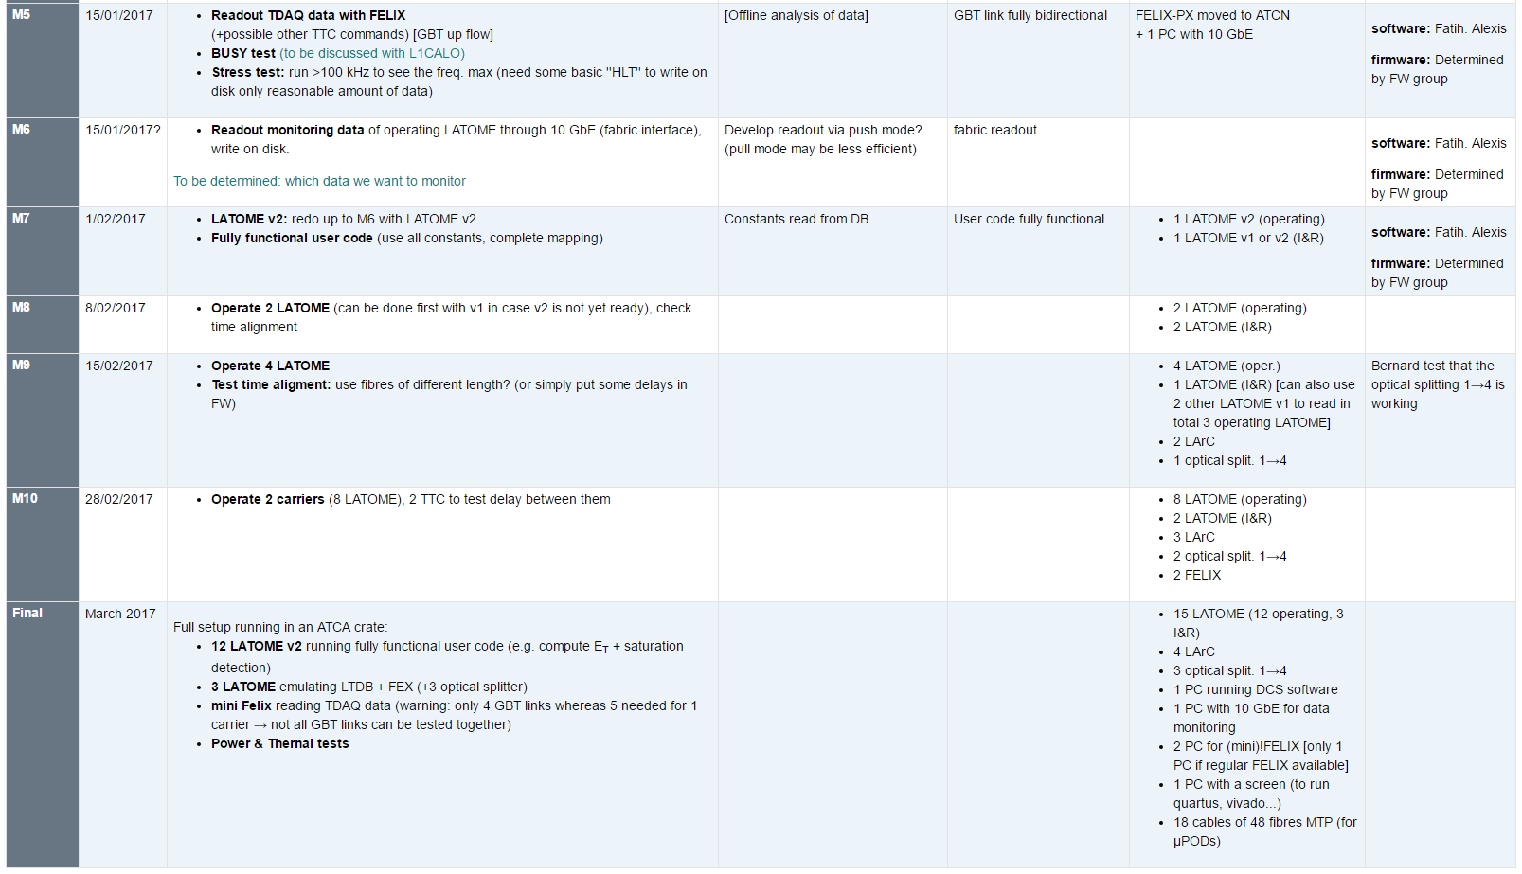
Back End System Test
ST-M0 completed on November 2016
Clock from FELIX well recovered on LArC and LATOME
ST-M1 had a slight delay, ~OK on January 2017
Good progress on firmware and software side to R&W in registers via 1GbE
DCS monitoring completed for ST-M2 on December 2016
ST-M3 will be the next major milestone: planned for March 2017
Inject LTDB data, and readout FEX data for comparison
ST-Mxx to M11: the last one to be completed ~Fall 2017

Slide 30
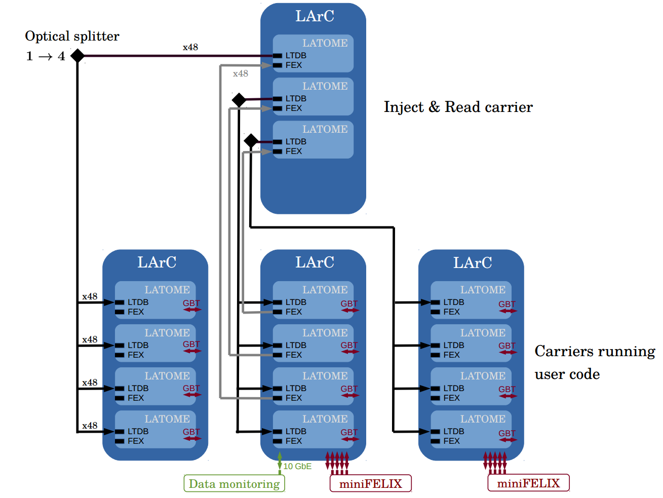
Test setup
1 carrier :
Inject « LTDB » data
Read « FEX » data
→ data verification
3 optical splitters 1→4 : feed the 3 other carriers
3 carriers running user code :
compute E_{T} for L1 (FEX)
Send data to TDAQ via FELIX
TTC signal via FELIX
Data Monitoring via 10 GbE
Test done at EMF

Slide 31
Number of boards
LTDB : 124
LAr Carrier : 31
LATOME : 124

Slide 32
Planning (1)

Slide 33
Planning(2)

Slide 34
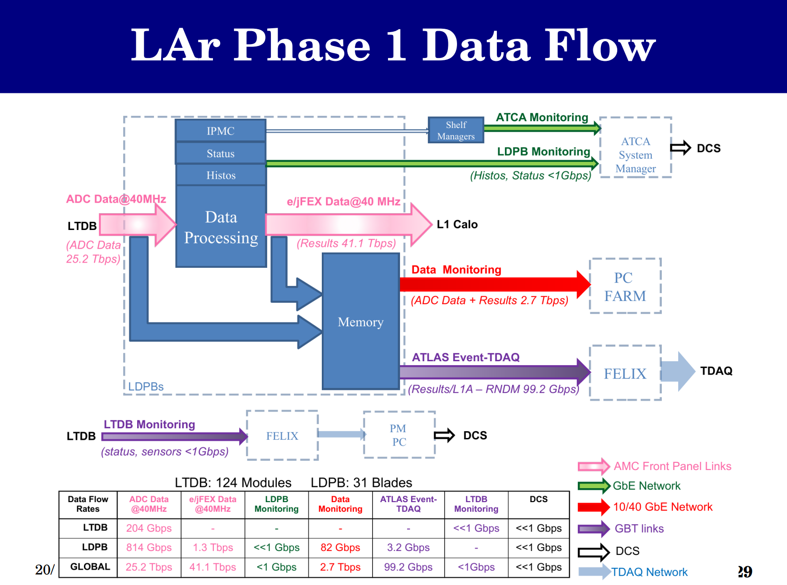
Phase-I Data Flow

Slide 35
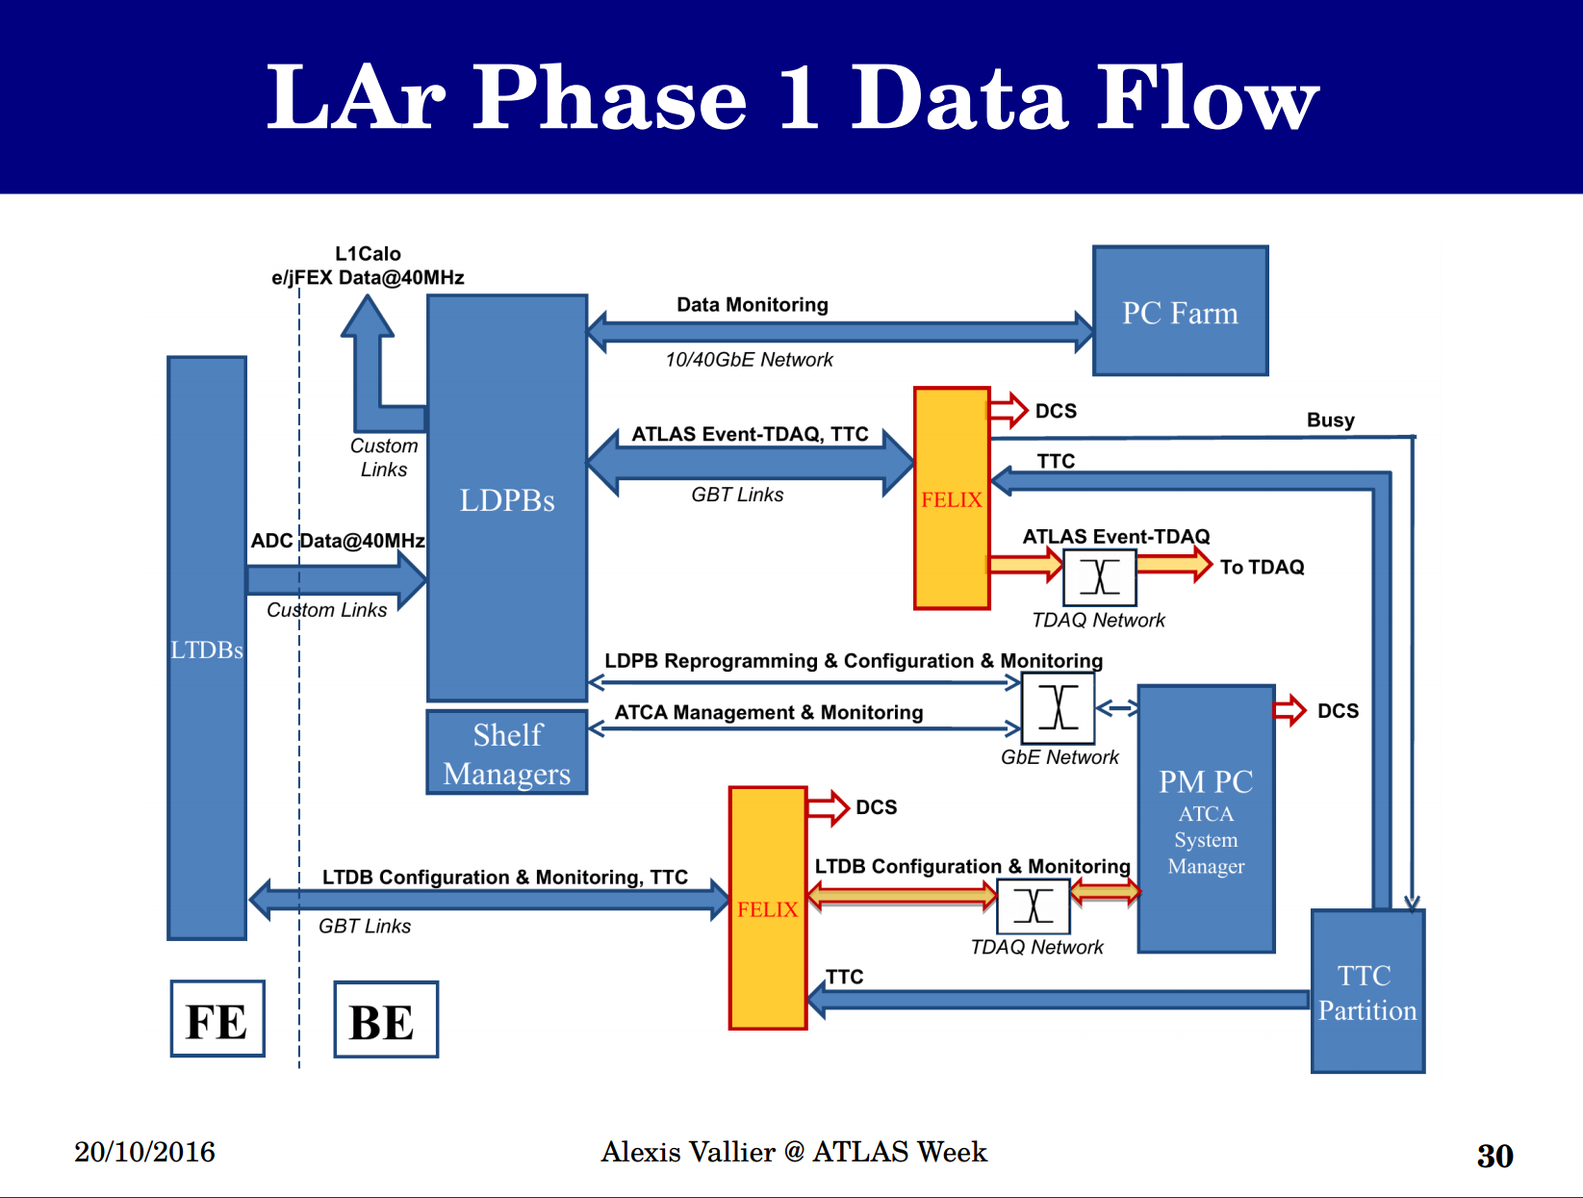
Phase-I Data Flow

